Slide 1
Practical Statistics for Data science Review
Exploratory Data Analysis

Slide 2
Chapter 5
Classification. Classical Approach

Slide 3
Introduction
Many data science problems require an automated decision
An email is an attempt of phishing?
Is a costumer (or employee) likely to churn?
Is a user likely to click an ad in a webpage?
These problems are known as Classification problems!
Classical Approaches to this problem
Naïve Bayes
Discriminant Analysis
Logistic Regression

Slide 4

Naïve Bayes classifier
The naive Bayes algorithm uses the probability of observing predictor values, given an outcome, to estimate the probability of observing outcome Y = i given a set of predictor values.
Conditional Probability: The probability of observing some event given some other event.
Intuition:
Find all the other records with the same predictor profile.
Determine what classes those records belong to, and which class is most prevalent.
Assign that class to the new record
$$P\left(A | B\right)=\frac{P\left(B | A\right)P(A)}{P(B)}$$

Slide 5
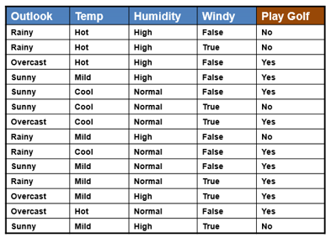
Naïve Solution Binary response
Let's predict the probability of going out play golf given the weather outlook, temperature, humidity and wind.

Slide 6
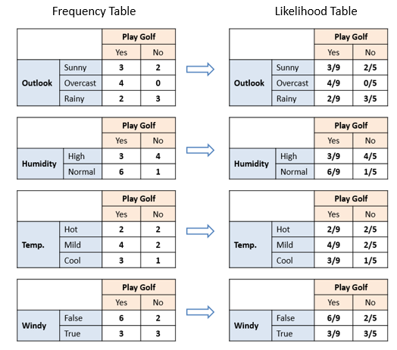
Naïve Solution Binary response
Estimate individual conditional probabilities for each predictor. This probability is estimated by the proportion of X values among the records in the training set. We can compute these probabilities using a frequency table.

Slide 7
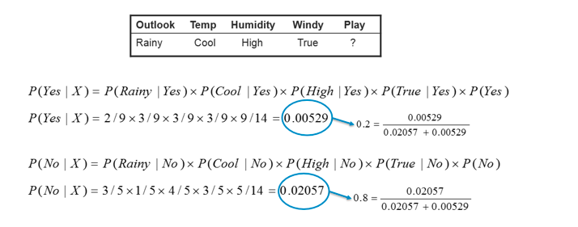
Naïve Solution Binary respone
Multiply these probabilities by each other, and then by the proportion of records belonging to Y.
Repeat steps 1 and 2 for all the classes.
Estimate a probability for outcome i by taking the value calculated in step 2 for class i and divide it by the total probability
Assign the record to the class with the highest probability.

Slide 8
Naïve Bayes Classifier key notes
Works with categorical predictors and outcomes.
Solves the question, “Within each category or class, which combination of predictors are most probable?
That information is inverted to estimate the probabilities of a class given the predictor values.
The method is called “naïve” because we simplify the calculation of the conditional probability assuming that the predictors are independent from each other.

Slide 9
Discriminant Analysis
Discriminant Analysis is the earliest statistical classifier, introduced by Ronald Fisher.
The most common technique is linear discriminant analysis (LDA)
Key terms
Covariance: A measure of the extent to which one variable varies in concert with another.
Discriminant function: Function that maximizer the separation of the classes.
Discriminant weight: Scores result from the application of discriminant function, used to estimate the probabilities of belonging to one class or another.

Slide 10
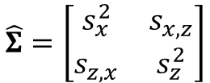

Covariance matrix
The covariance measures the relationship between two variables X, Z.
The covariance matrix consists of the individual variable variances on the diagonal and the covariances between variable pairs on the off-diagonals. Is the multivariate extension of the variance concept.
$$S_{x,z}=\frac{\sum_{i=1}^{n}{\left(x_{i}−\overline{x}\right)}\left(z_{i}−\overline{z}\right)}{n−1}$$
$$\hat{Σ}=\left[\begin{matrix}s_{x}^{2} & s_{x,z} \\ s_{z,x} & s_{z}^{2}\end{matrix}\right]$$

Slide 11



Fisher’s Linear discriminant
Lets focus on a classification problem of a binary response y using just two continues numeric variables (x, z). Fisher’s linear discriminant distinguishes variation between groups, on the one hand, from variation within groups on the other.
The method finds the linear combination
that maximizes the sum of squares ratio
Solved by
$$∆=w_{x}x+w_{z}z$$
$$\frac{{SS}_{between}}{{SS}_{within}}$$
$$W=\left[w_{x},w_{z}\right]={\hat{Σ}}^{−1}\left(μ_{x}−μ_{z}\right)$$

Slide 12
Key ideas for discrimant analysis
Discriminant analysis works with continuous or categorical predictors, as well as categorical outcomes.
Using the covariance matrix, it calculates a linear discriminant function, which is used to distinguish records belonging to one class from those belonging to another.
This function is applied to the records to derive weighs, or scores, for each records that determines its estimated class.

Slide 13
Logistic Regression
Logistic regression is analogous to multiple linear regression, except the outcome is binary. Is a popular method due its fasts computational speed and is a structured model approach, rather than data centric approach like naïve bayes or K-nearest neighbors.
The key ingredient are the logistic response function and the logit, in which we map a probability (0-1 range) to a more expansive scale suitable for linear regression.

Slide 14
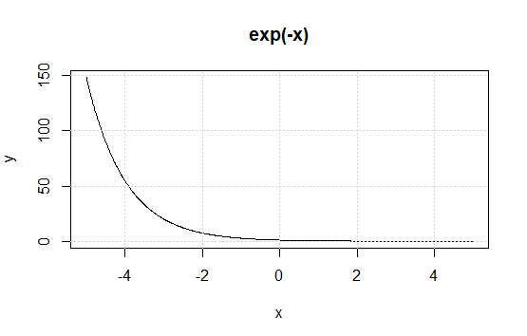


Logistic response function and logit
Think that we can model the probability that the label of our response is a Y=1 as a linear function of the predictor variables.
Fitting this model doesn't ensure that p will end up between 0 and 1 range though. Instead, we model p by a logistic response or inverse logit function to the predictors
And we now ensure that p stays between 0 and 1.
$$p=β_{0}+β_{1}x_{1}+β_{2}x_{2}+…+β_{q}x_{q}$$
$$p=\frac{1}{1+e^{−\left(β_{0}+β_{1}x_{1}+β_{2}x_{2}+…+β_{q}x_{q}\right)}}$$

Slide 15


Logistic response function and logit
To get the exponential out of the denominator, we consider odds (probability of an event divided by the probability that the event will not occur) instead of probabilities.
Or the inverse form
$$Odds\left(Y=1\right)=\frac{p}{1−p}$$
$$p=\frac{Odds}{1+Odds}$$

Slide 16
Logistic response function and logit
Combining this with the logistic response we get
And taking the logarithm we get the logit function
$$Odds\left(Y=1\right)=e^{β_{0}+β_{1}x_{1}+β_{2}x_{2}+…+β_{q}x_{q}}$$
$$log⁡(Odds\left(Y=1\right))=β_{0}+β_{1}x_{1}+β_{2}x_{2}+…+β_{q}x_{q}$$

Slide 17
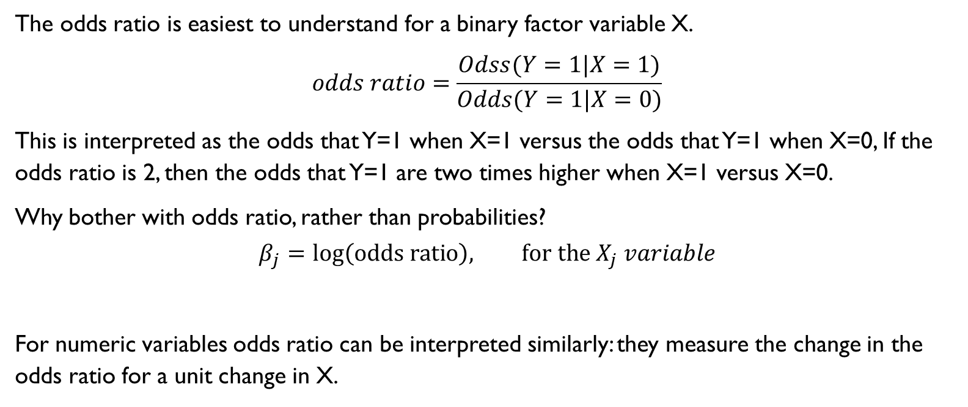

Interpreting coefficients $β_{j}$ and odds ratios
The odds ratio is easiest to understand for a binary factor variable X.
$$odds ratio=\frac{Odss(Y=1|X=1)}{Odds(Y=1|X=0)}$$
This is interpreted as the odds that Y=1 when X=1 versus the odds that Y=1 when X=0, If the odds ratio is 2, then the odds that Y=1 are two times higher when X=1 versus X=0.
Why bother with odds ratio, rather than probabilities?
$$β_{j}=log\left(odds ratio\right), for the X_{j} variable$$
For numeric variables odds ratio can be interpreted similarly: they measure the change in the odds ratio for a unit change in X.

Slide 18
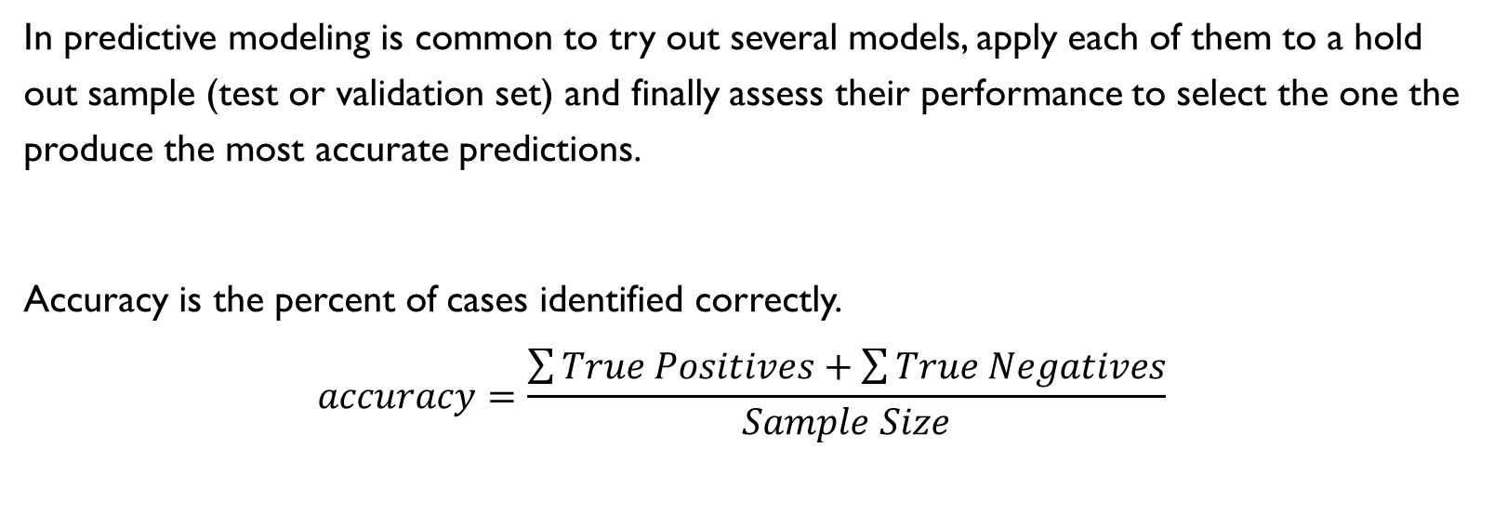
Evaluating Classification models
In predictive modeling is common to try out several models, apply each of them to a hold out sample (test or validation set) and finally assess their performance to select the one the produce the most accurate predictions.
Accuracy is the percent of cases identified correctly.
$$accuracy=\frac{\sum{True Positives}+\sum{True Negatives}}{Sample Size}$$

Slide 19
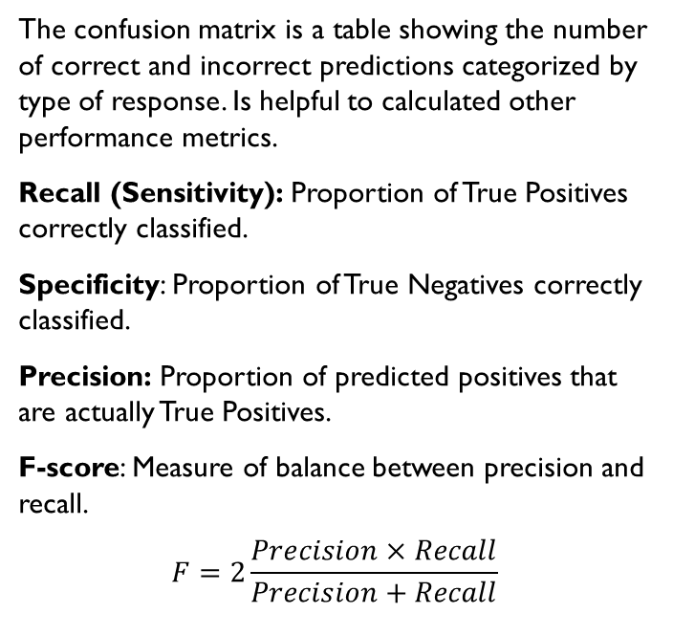
Confusion matrix
The confusion matrix is a table showing the number of correct and incorrect predictions categorized by type of response. Is helpful to calculated other performance metrics.
Recall (Sensitivity): Proportion of True Positives correctly classified.
Specificity: Proportion of True Negatives correctly classified.
Precision: Proportion of predicted positives that are actually True Positives.
F-score: Measure of balance between precision and recall.
$$F=2\frac{Precision×Recall}{Precision+Recall}$$
0

Slide 20
Roc Curve
There is a natural tradeoff between recall and specificity, capturing more “1’s” generally means misclassifying more 0’s as 1’s.
The metric that captures this tradeoff is the Receiver Operating Characteristics curve. The process to compute the curve is:
Sort the records by the predicted probability of being 1, starting with the most probable and ending with the last probable.
Compute the cumulative specificity and recall based on the sorted records.

Slide 21
AUC area under the curve
The ROC curve is a valuable graphical tool but doesn’t constitute a measure for the performance of a classifier. However, we can calculate the area under the ROC to have a performance metric.
The larger the value of AUC the more effective the classifier, having AUC=1 the perfect classifier and AUC=0.5 a completely ineffective classifier.

Slide 22
Lift?

Slide 23
Evaluating Classification models Key ideas
Accuracy is a good first step in model evaluation but shouldn’t be your only performance metric.
Other performance metrics such as recall specificity and precision focus on other valuable characteristics of your model.
AUC is a good metric to test the ability of a model to distinguish positives from negatives.

Slide 24
Imbalanced data
Having imbalanced data is a very problematic when dealing with classification modeling . There are some strategies that can improve predictive modeling performance when your dataset has class imbalance.
Under sampling: Use fewer of the prevalent class records in the classification model.
Oversampling: Use more of the rare class records in the classification model, bootstrapping if necessary.
Up weight or down weight: Attach more or less weight to the rare (or prevalent) class in the model.

